Slide 1

PROPOSAL · ISP NETWORK OBSERVABILITY PLATFORM
See the whole network before your customers call.
A proposal to pilot one screen for links, routers, sectors and subscribers, with alerts that say what broke and why.
Notes:
Opening line: today most outages are discovered when a customer phones. This platform flips that. [Presenter name / client name / date]

Slide 2
Today, customers are the monitoring system.
Blind spots
Alert storms
Slow decay
Radios, routers and sectors each have their own tool or none at all.
One tower fails and fifty alarms bury the real cause.
A weakening signal or a creeping noise floor goes unseen until it becomes an outage.
ISP Network Observability Platform
Notes:
Set up the pain. Ask the room how they usually learn about an outage.

Slide 3
Every layer of the network, in one view.
BACKHAUL
CORE
ACCESS
CUSTOMERS
PTP links
Routers
Sectors
Subscribers
AirMAX, AirFiber and SAF radios scored on one health scale.
CPU, memory, uptime and interface traffic for every MikroTik.
Clients, throughput, noise floor and every CPE's signal.
Who is online, who should be, and why someone dropped.
ISP Network Observability Platform
Notes:
Four layers, one platform. Next slides show each layer's interface.

Slide 4
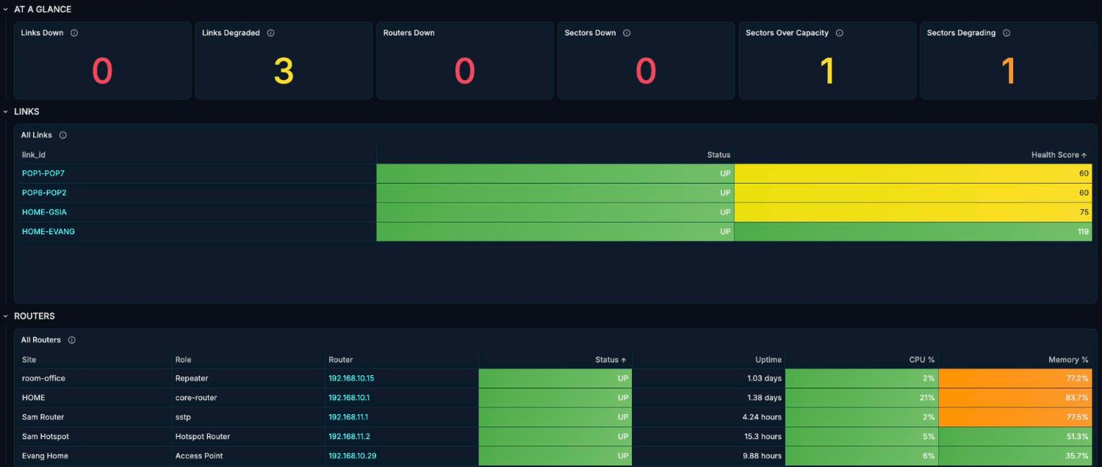
One screen for the whole network.
Incidents on top
State counts
Click-through
Every firing alert sits above this view, one row per object, longest-running first.
Links, routers and sectors up or down at a glance, with CPU, memory and uptime per router.
Any link or router row opens its detail view.
ISP Network Observability Platform
Notes:
Live capture of NOC Overview (counts, links and routers). The incidents table is cropped out because it lists client names. Every router row is clickable to its detail view.

Slide 5
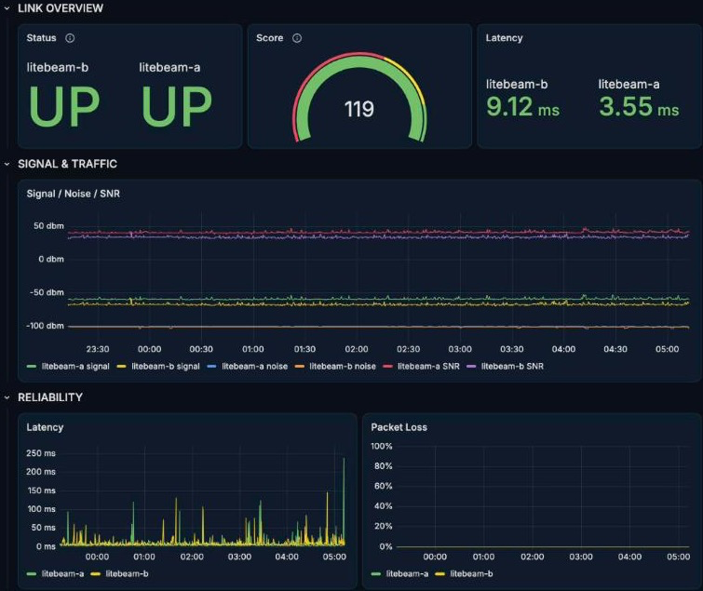
Every backhaul link, scored.
One health score
Any vendor, same scale, so weak links stand out.
Latency and loss
Measured continuously, shown over time.
Signal, noise and SNR
RF quality tracked before users feel it.
ISP Network Observability Platform
Notes:
Live capture from the lab Grafana (one link). Utilisation tiles show N/A on some radios because airMAX exposes no capacity counters over SNMP, so they are cropped out.

Slide 6
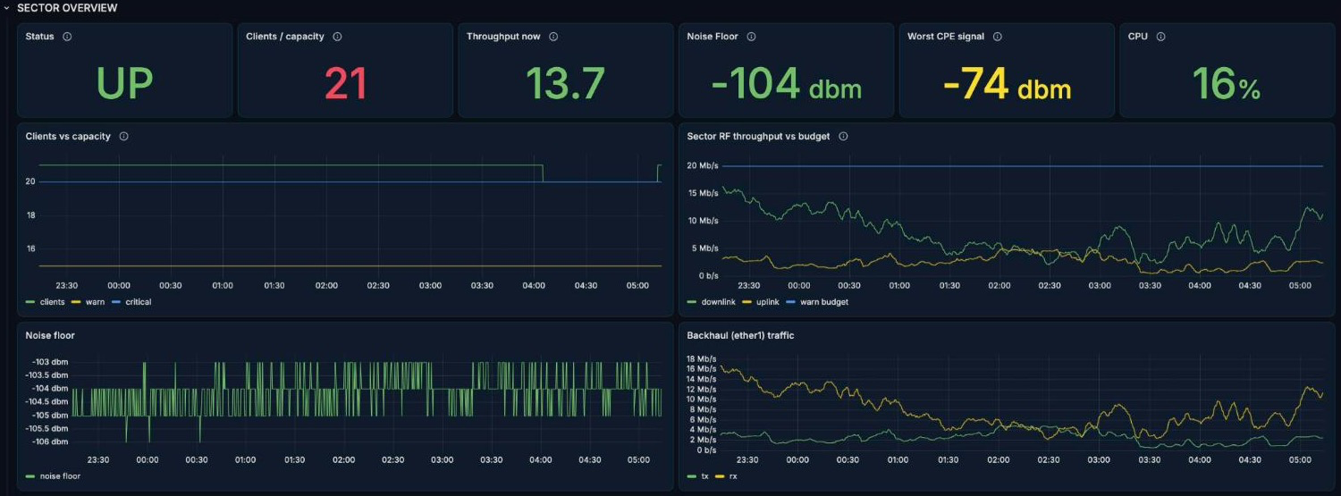
Every sector, and every CPE behind it.
Capacity
Worst CPE first
Noise floor
Clients and Mbps against each sector's limits.
The weakest CPE signal on each sector, shown up front.
Interference visible before it hurts customers.
ISP Network Observability Platform
Notes:
Live capture from the lab Grafana, taken 9 Oct 2026.

Slide 7
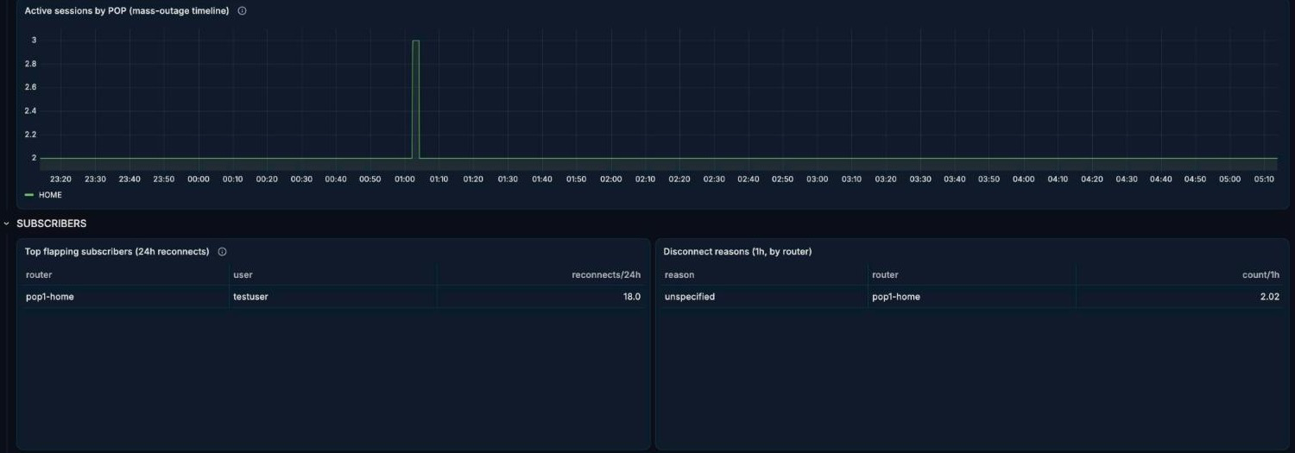
Who is online, and who should be.
Sessions per POP
Mass-outage detection
Why they dropped
Online subscribers over time, per POP.
A sudden drop per POP or router is flagged at once.
Disconnect reasons and the most-flapping subscribers.
ISP Network Observability Platform
Notes:
Live capture from the lab Grafana. Provisioned-vs-online tiles sit above this crop; the lab has only test subscribers.

Slide 8
Live walkthrough: from alert to cause in minutes.
[Insert screen recording]
1 Telegram alert arrives
2 Open NOC Overview
3 Click through to the link
4 Drill into the sector and CPE
ISP Network Observability Platform
Notes:
Record a 90-second screen capture (on a Mac: Shift+Cmd+5, record selected portion) before the meeting, since the monitored network may not be reachable from the venue. Suggested storyboard: (1) a Telegram alert arrives, (2) open NOC Overview and find the incident, (3) click the link row and show latency, loss and signal, (4) open the sector and show the worst CPE. Narrate live over a muted recording. Replace the placeholder box with the video, or play it full screen from this slide. Blur client names before recording.

Slide 9
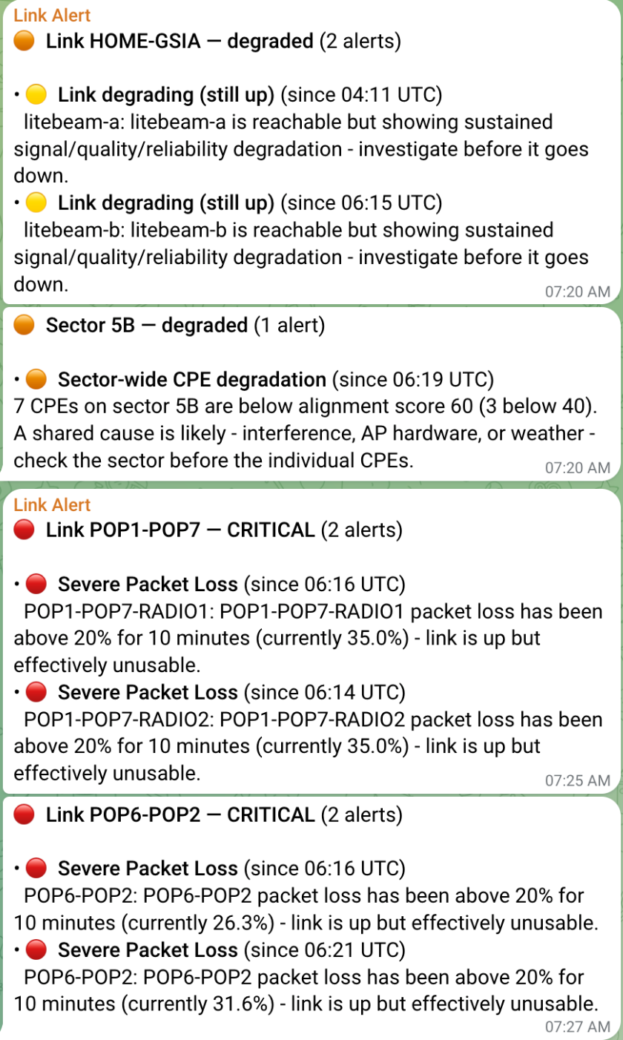
One failure, one message.
2
Dependency-aware
If a POP's router or backhaul is down, every sector behind it is marked unreachable, not alarmed separately.
Telegram messages for a whole link outage
Symptoms suppressed
One when it fails, one when it recovers.
When a link is down, its signal, loss and error alerts stay quiet. You see the cause only.
Knows when it cannot see
If the monitoring server loses its own network, one alert says so and the rest stay quiet.
ISP Network Observability Platform
Notes:
The Telegram image is a live capture of the Monitoring Team group, cropped to the alert messages only. The "2 messages" figure comes from the failure drill in docs/failure-drills.md (firing plus resolved). Alerts are grouped per object and delivered to Telegram.

Slide 10
Alerts reach you where you are.
TELEGRAM
WHATSAPP
COST CONTROL
QUIET
Every alert
Real outages only
Capped by design
No resolve spam
The NOC group gets every alert, one message per failure. Free, and the primary channel.
Only outages lasting 30+ minutes reach the on-call phone, so weather fades do not. The rest stays on Telegram.
No recovery messages on WhatsApp, and a warning clearing sends no ping on Telegram.
Starts in dry-run. Hard daily and monthly message limits, and a warning at 80% of the budget.
ISP Network Observability Platform

Slide 11
It also catches what slowly goes wrong.
Compared to itself
Quiet bleeds
Earlier warning
Each metric is judged against its own recent baseline, not one fixed threshold.
A subscriber count that erodes, or router CPU and memory that creep upward.
You fix it while customers are still online.
ISP Network Observability Platform
Notes:
Source: docs/tier2-anomaly-detection.md. Compares the last hour with the previous six hours.

Slide 12
It also watches the server it runs on.
HOST
ALERT PATH
STACK
DASHBOARD
Disk, RAM, CPU
Delivery checked
Every component
Server Health
Alerts when disk is almost full or filling fast, memory runs low, CPU saturates or the clock drifts.
Alerts if rules stop evaluating or Alertmanager cannot deliver a notification.
Host load, storage trend, component status and the WhatsApp message budget on one page.
Prometheus, Grafana, Alertmanager and each probe are checked. One alert says which is down.
ISP Network Observability Platform

Slide 13

Everything you watch today, and more.
TODAY
THIS PLATFORM
Ubiquiti monitoring, The Dude, PRTG
All of it, on one screen
Link and radio status, capacity and device state, spread across separate tools.
Every radio family and router, with status and capacity side by side.
ADDED ON TOP
History
CPE and subscriber depth
Alerts with a cause
Early warning
Trends over time, so you see what changed and when.
One message per failure. Symptoms behind a down link stay quiet.
Slow decay caught against a normal baseline.
Signal per CPE and PPPoE sessions, not just the radio.
ISP Network Observability Platform
Notes:
Today the team watches link and radio status, capacity and status in Ubiquiti's monitoring, The Dude and PRTG. All of that is covered here, so nothing is lost by moving. The value is what the older tools do not give you: history, per-CPE and per-subscriber views, cause-first alerting, and drift detection. Platform software has no per-sensor licence fee, but needs a named owner and has no vendor support desk.

Slide 14
Already running in our lab, on real equipment.
10
40+
4
Tested
Dashboards
Alert rules
Radio families
Alert logic
From NOC overview to a single CPE.
Links, routers, sectors, CPEs and subscribers.
MikroTik, AirMAX, AirFiber and SAF.
Automated tests prove the rules fire and stay quiet correctly.
ISP Network Observability Platform
Notes:
Be candid: this is a lab with a handful of devices, one sector, and limited subscriber data. What is untested is behaviour at full network scale and across all sectors. That is exactly what the pilot is for. Rule count is from prometheus/rules (46 alert definitions, some per-vendor duplicates). Confirm the four radio families before presenting.

Slide 15
WHAT ROLLOUT NEEDS: SECTOR MANAGEMENT
A sector can only be monitored if the server can reach it.
A route on each side closes the gap, with no effect on subscribers.
Notes:
Transition into the practical section. Everything that follows is the per-sector setup.

Slide 16

Only one thing stops the server reaching a sector.
Monitoring server
POP router
Sector
Polls SNMP and ping.
Has no route to the sector.
No route to the POP router, and none back.
The only blocker: no route in either direction. The sector cannot reach the POP router, and the POP router cannot reach the sector.
Without both routes, ping, SNMP, Winbox and NTP cannot get there or come back. Add them and the server sees each sector at its real address.
ISP Network Observability Platform
Notes:
Confirm the topology wording with the network team. The POP router's masquerade rule is no longer needed for these sectors once the route is in.

Slide 17
The fix: one route on each side.
On the sector: a route to the POP router
/ip route add dst-address=0.0.0.0/0 gateway=<POP-router-IP> comment="mgmt route"
On the POP router: a route to the sector
/ip route add dst-address=<sector-IP>/32 gateway=<next-hop-to-sector> comment="mgmt -> sector"
Check with /ip route print and /ping <monitoring-server-ip> count=3. Also confirm read-only SNMP is enabled on the sector, limited to the monitoring server.
ISP Network Observability Platform
Notes:
Both commands are templates: confirm the sector subnet, the next hop and whether the sector should get a default route or only a route to the monitoring network. Replaces the old Fix 1 and Fix 2 slides. Optional extras on the sector: /system ntp client set enabled=yes servers=<ntp-server>, and remote logging to the monitoring server (feeds Loki later). SNMP: /snmp community add name=<community> addresses=<monitoring-server-ip>/32 read-access=yes write-access=no, then /snmp set enabled=yes. Never put the real community string on a slide.

Slide 18
Safe to roll out during the day.
No subscriber impact
What you gain
ether1 and wlan are bridged, so client traffic crosses the sector at Layer 2 and never uses its routing table. The route only carries traffic the sector itself sends.
The server sees each sector's real source address, the POP masquerade rule is not needed, and sector A can ping sector B through the router.
Server test: ping <sector-ip>
snmpwalk -v2c -c <community> <sector-ip> 1.3.6.1.2.1.1
ISP Network Observability Platform
Notes:
This is the reassurance slide: the change can be made in business hours.

Slide 19
What it takes to run.
FOOTPRINT
ACCESS
RISK
PEOPLE
One Linux server
Read-only
No subscriber impact
A named owner
Hosted locally in your own network. The whole stack runs in Docker on one machine.
SNMP and RouterOS API read access only, limited to the monitoring server. Monitoring changes nothing.
One person who keeps it updated and tunes alerts. There is no vendor support desk.
Setup is two routes per sector, done in business hours. Client traffic never uses them.
ISP Network Observability Platform
Notes:
Server specification: add the actual machine (CPU, RAM, disk) used in the lab and the planned production host. Prometheus keeps 15 days of history by default; this can be raised if disk allows. The named-owner point is the honest trade-off versus a commercial tool with a support contract.

Slide 20
No new way into the network.
PLACEMENT
ACCESS
DIRECTION
SECRETS
Management side
Read-only
Outbound only
Kept out of git
The server sits only on the management network, with no leg in the customer network.
SNMP and RouterOS read access, limited to the server's address. It cannot change any device.
Passwords and tokens are Docker secrets in local files, never in the repository.
Only the server calls out (Telegram, optional WhatsApp). Nothing is exposed to the internet.
ISP Network Observability Platform

Slide 21
How the server itself is kept safe.
FIREWALL
DEVICES
HARDENING
TO KNOW
Ports restricted
Locked at source
Pinned and patched
Honest limits
Dashboards open only to NOC workstations. Probe ports are closed to everyone but the server.
Each router and sector accepts SNMP and API only from the monitoring server's address.
SNMPv2c is cleartext on the management network, and the server holds read-only logins. Guard it.
Version-pinned images, no auto-update, SSH keys only, strong Grafana password, viewer accounts for staff.
ISP Network Observability Platform

Slide 22
Proposed pilot: one POP first, then widen.
PHASE 1 · [WEEKS]
PHASE 2 · [WEEKS]
PHASE 3 · [WEEKS]
Connect
Observe
Decide
Add the management route and SNMP on the sectors of one POP. Confirm each appears in the dashboards.
Tune capacity thresholds and alert routing. Compare what it flags with what customers report.
Review against agreed success measures, then roll out to the remaining POPs.
Success measures to agree: [outages detected before customer calls] · [false alarms per week] · [time to find the cause]
Notes:
Fill in durations and the measures the bosses care about. Suggest measuring against the previous month's outage log so the comparison is fair.

Slide 23
How we judge the pilot.
DETECTION
NOISE
DIAGNOSIS
Outages flagged before a customer calls
False alarms per week
Time to find the cause
≤ [5]
≤ [10] min
≥ [80]%
Alerts that needed no action. Thresholds are tuned in phase 2.
From first alert to the failing link, router or sector.
Compared with the pilot POP's own outage log.
ISP Network Observability Platform
Notes:
The targets in brackets are proposals, not commitments: agree them with the decision-makers and set them against the pilot POP's recent outage log, if one exists. Keep to three measures so the pilot result is easy to read.

Slide 24
After the pilot.
NEXT
IN PROGRESS
PLANNED
BUILT, TUNING IN PILOT
Remaining POPs
Per-subscriber PPPoE detail
Log search
Capacity planning
Roll out sector by sector once the pilot measures are met.
Router and sector logs searchable beside the graphs, using Loki.
Session-level views per subscriber, building on today's subscriber overview.
A daily 08:00 digest of sectors nearing their client or throughput limits.
ISP Network Observability Platform
Notes:
Be clear which items exist today and which are planned. Capacity digest is already running in the lab; Loki log search and the full PPPoE views are not yet in production.

Slide 25
THE ASK
Approve a pilot on one POP.
Choose the POP
Assign an engineer
Agree the measures
Pick the site and its sectors for the pilot.
To apply the route and SNMP change on each sector.
Decide how we judge the pilot a success.
Notes:
Close on the decision you want in the room today. Adjust the three asks to what you actually need from them.

